Slide 1
WBC Active Travel update
Farnham Cycle Campaign AGM, 25th November 2024

Slide 2
Context
Waverley Borough Council’s Carbon Neutrality Action Plan
In September 2019, Waverley Borough Council passed a motion declaring a climate emergency and committing the council to become a carbon neutral council by 2030*
*1% of carbon emissions across the borough are directly from Waverley Borough Council activities and services

Slide 3
Context
Waverley Borough Council’s Carbon Neutrality Action Plan
Beyond the council’s own emissions:
Travel and transport are responsible for 46% of Surrey’s carbon emissions^{ǂ}
Around 66% of this is due to car usage*
^{ǂ}Surrey Climate Change Strategy (2020)
*Surrey Climate Commission's Carbon Baseline Study, Erica Russell with Ian Christie, Richard Murphy, Centre for Environment & Sustainability, University of Surrey (2021)

Slide 4




Waverley and sustainable transport
Sustainable Travel
Active
LCWIP
Cycle parking
Greenways
Notes:
Local Cycle and Walking Infrastructure Plan following DfT guidance

Slide 5
Greenways
Guildford – Godalming: SCC led, Phase 1 programmed
Godalming Gateway: WBC led, in procurement
Hale Trail: major project for WBC, SCC do provide feasibility design
Scholars: improvements via planning (WBC)
Weyside: WBC supporting SCC for section from Riverside to South St section
        Looking at Kimbers Lane to Guildford Road Trading Estate section

Slide 6
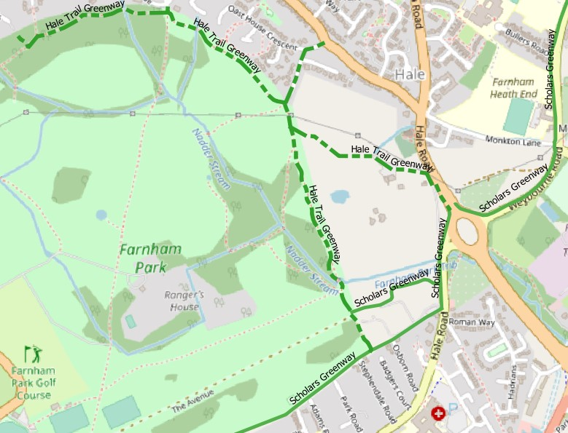
Greenways
SCC
Planning

Slide 7
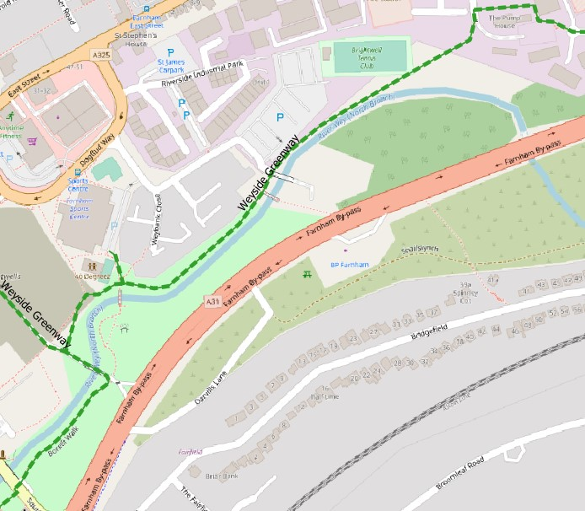
Greenways
WBC
SCC

Slide 8
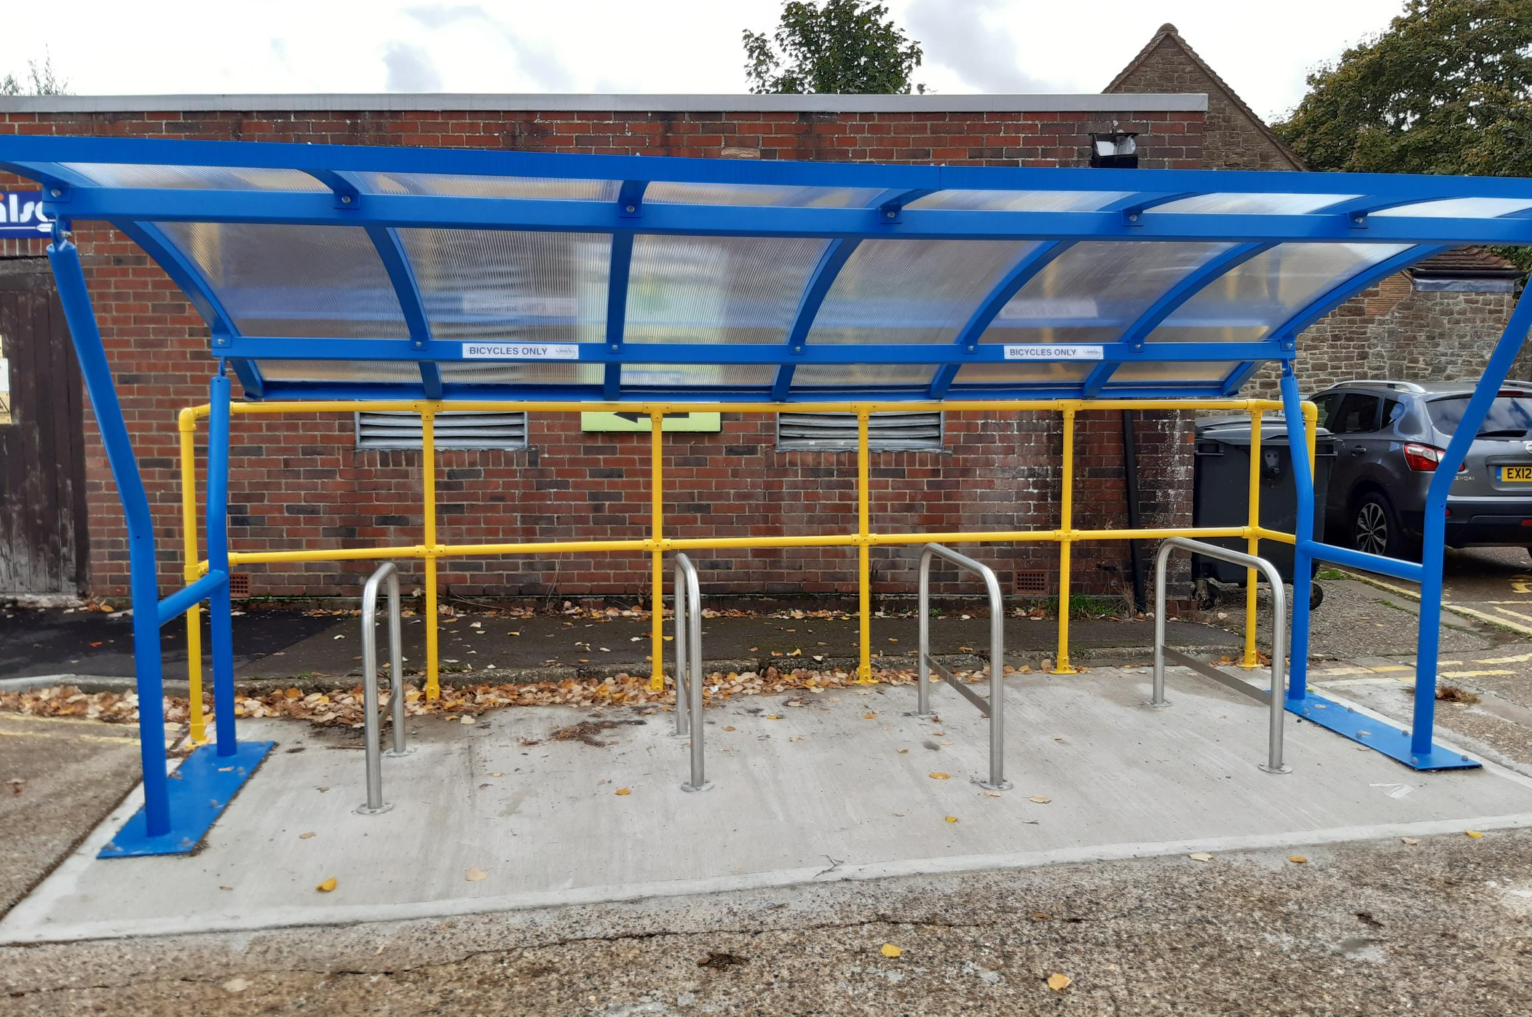
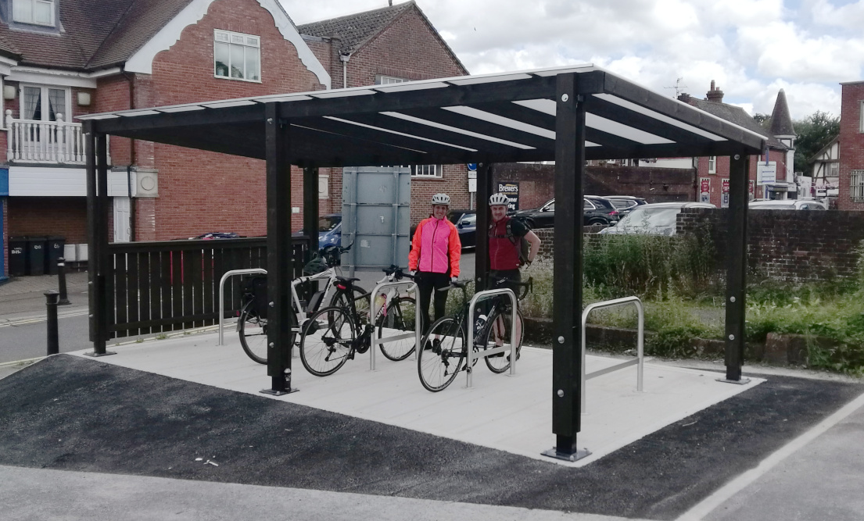
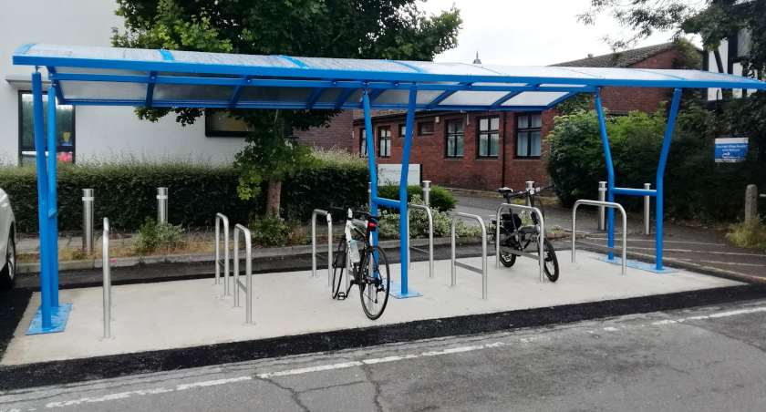
Cycle shelters
High Street car park, Haslemere
Crown Court, Godalming
Village Way, Cranleigh

Slide 9
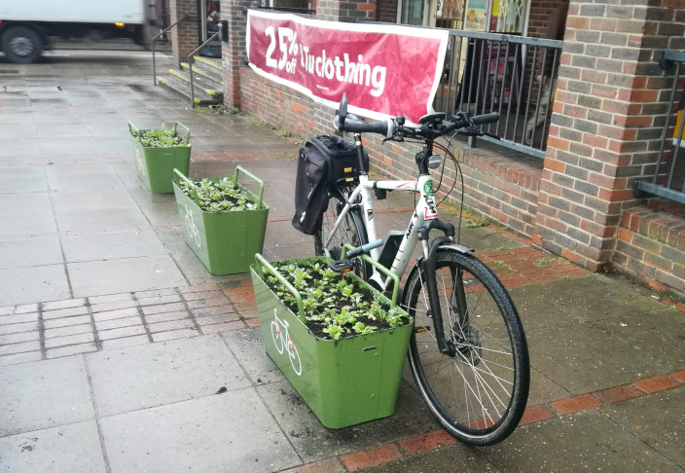
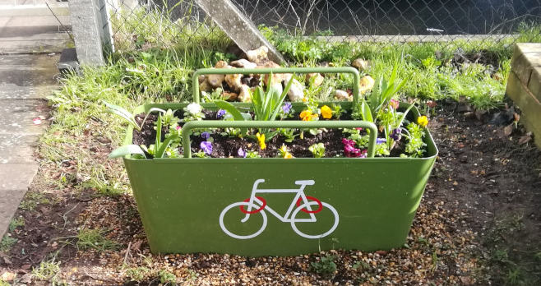
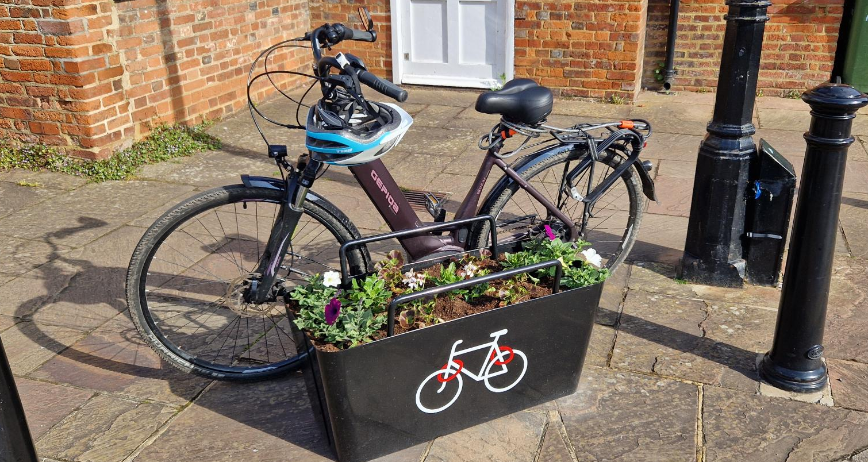
‘PlantLock’ loan scheme
Hale Community Centre
Sainsburys, South Street
New Ashgate Gallery, Waggon Yard

Slide 10
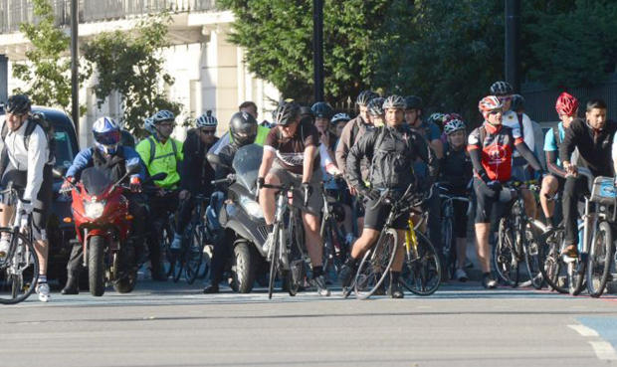
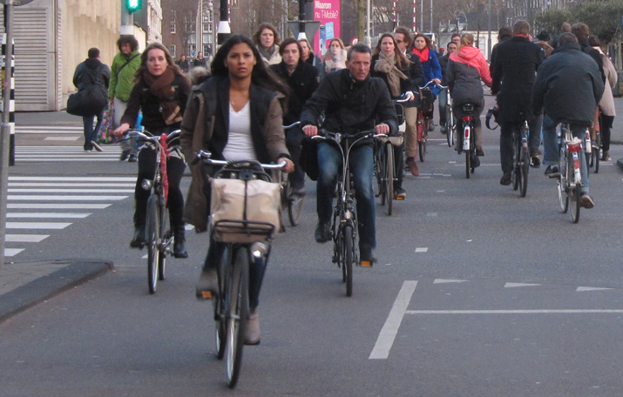
Local Cycle and Walking: where to build the infrastructure?
Where it is easy to build?
Where there is already walking & cycling?
Where there is the most potential?

Slide 11


LCWIP: programme
WBC endorsement
May 2024
Executive
adoption
Priority infrastructure detailed design
2025
Add to IDP
(Infrastructure
Delivery Plan)
October 2024
Bid to DfT Active Travel Fund
2026?
At the next LPP1 revision, potential to add LCWIP references to sustainable transport policies
Build funded infrastructure
2026?
Notes:
Coordinated and complimentary actions

Slide 12
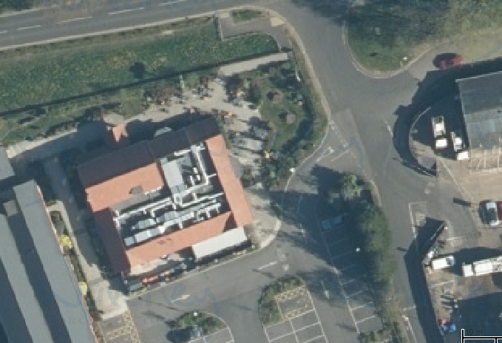
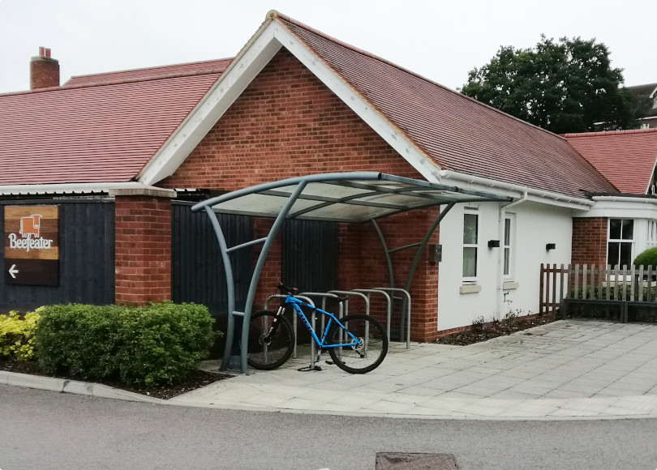
Opportunity lost…
Premier Inn development

Slide 13
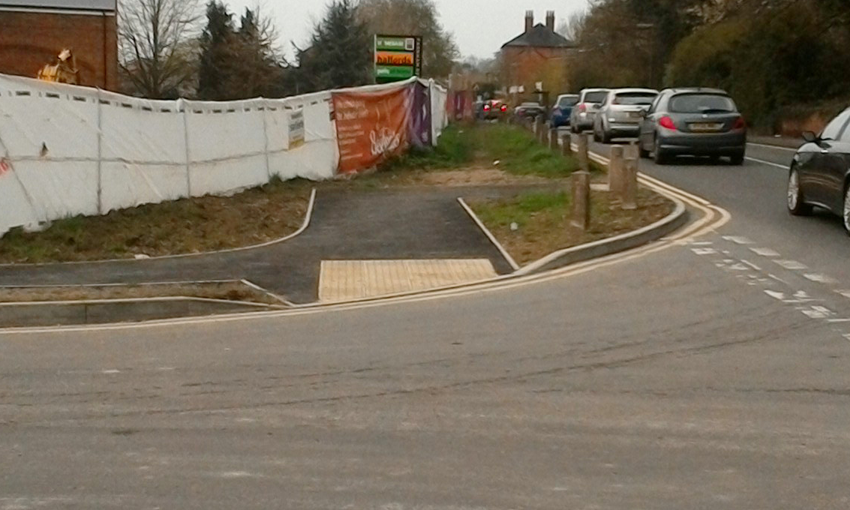
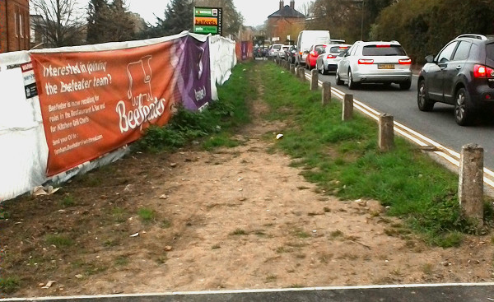
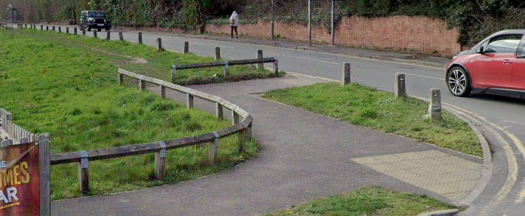
Opportunity lost…
Premier Inn development

Slide 14
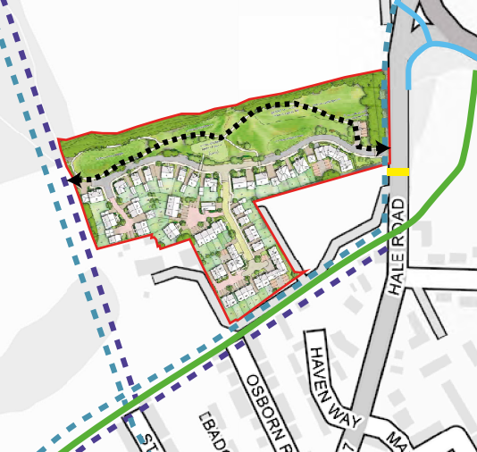
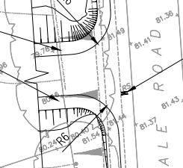
Opportunity created…
Hawthorns planning application (2021)
LTN1/20 compliant link for Scholars Greenway to Farnham Park
2m wide footway
Drop kerbs, pedestrian crossing point

Slide 15
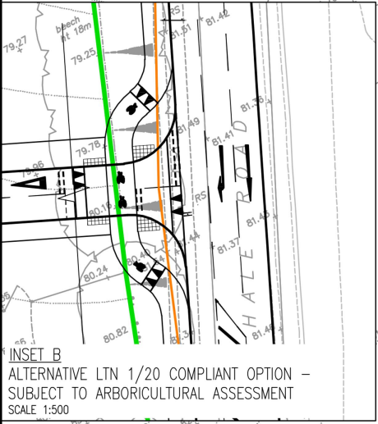
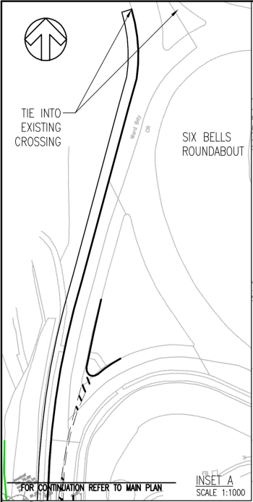
Opportunity created…
Hawthorns planning application (2022)
“LTN 1/20 cycle crossing of the access road”
3m wide shared use path: 6 Bells roundabout to pub

